Slide 1



LGBT Inclusive Education
A Brief Introduction to the National Approach (2024)

Slide 2



Research
LGBT Inclusive Education Progress and Evaluation Report (2023)
  96% of primary school learners felt that resources about the use of homophobic language at school were ‘very relatable’
  82% of secondary learners hear anti-LGBT language and slurs used at school
  49% had experienced or witnessed anti-LGBT bullying at school
Online in Lockdown (2020)
  72% of LGBT young people had seen more prejudice online during lockdown. This is more than double the rate of their peers
  36% (over 1 in 4) of LGBT young people experienced online bullying during lockdown, with 76% of them saying that this had been happening more than usual

Slide 3


Slide 4
What is LGBT Inclusive Education?
A proactive, educational approach to addressing the stigma, stereotypes and prejudice which often leads to bullying and social exclusion of pupils who are LGBT, are perceived to be by others, or who have LGBT family members
Integrating the teaching of LGBT Learning Themes into the learning pathway from the Broad General Education to the Senior Phase
Inclusion of LGBT Learning Themes in a way that is meaningful, relevant, and part of year-round ordinary learning, rather than exceptional or only within the context of calendar months or one-off occasions
The national ‘Delivering LGBT Inclusive Education’ professional learning and national platform lgbteducation.scot support teachers with the resources, guidance, and knowledge to undertake this work successfully

Slide 5
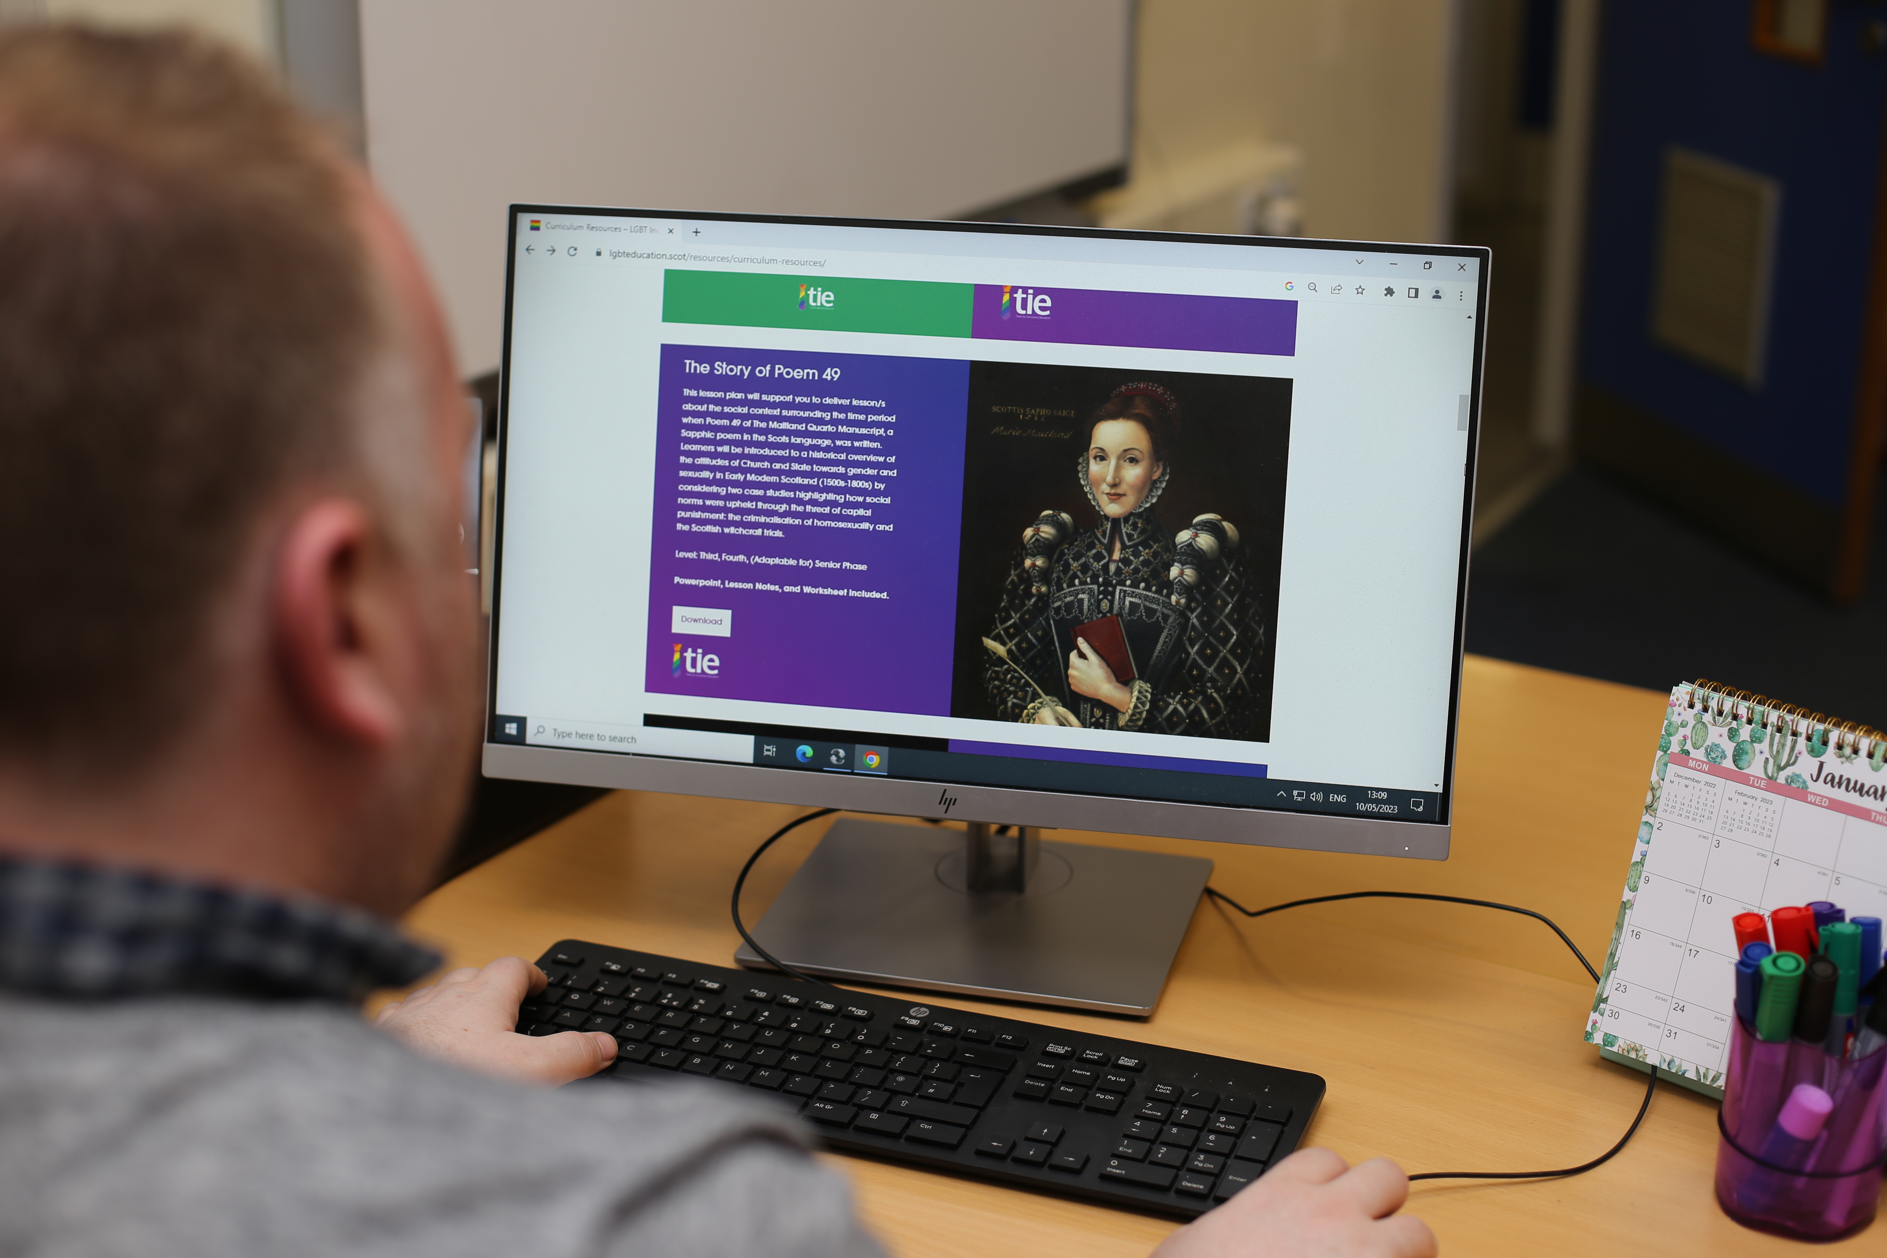
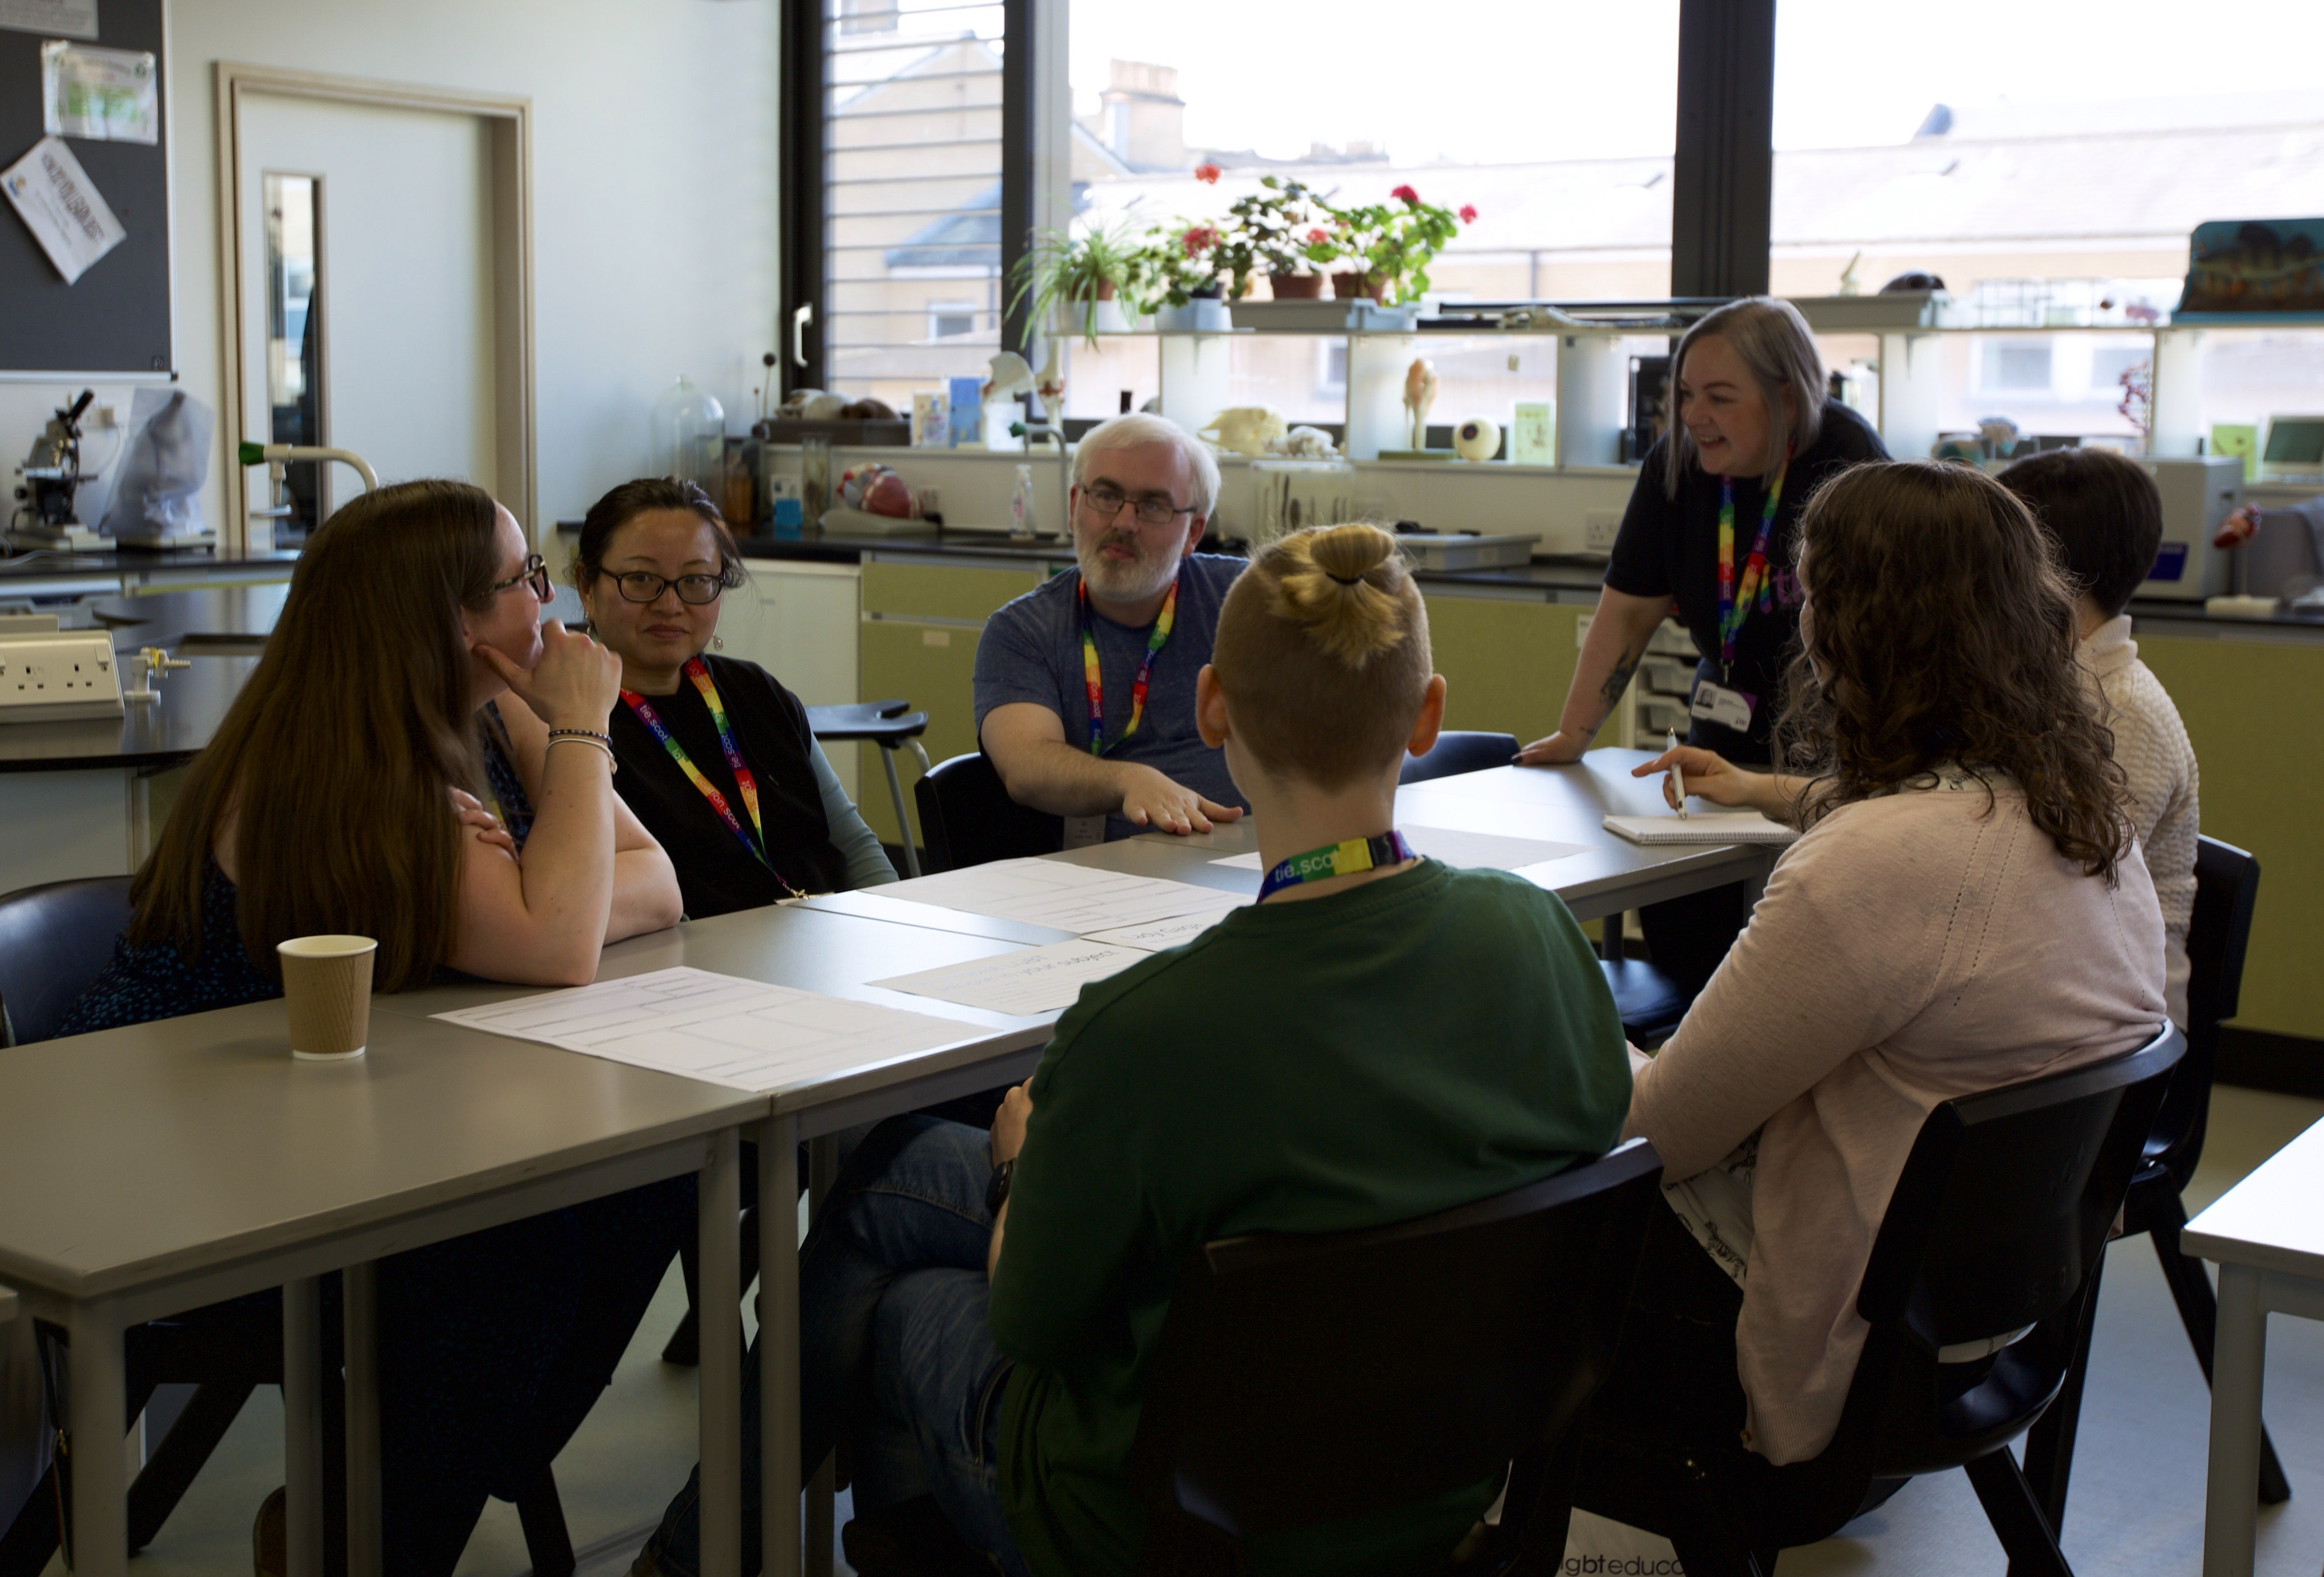
‘Delivering LGBT Inclusive Education’ Professional Learning
Stage 1 E-Learning module
  Available on the national platform, lgbteducation.scot
  Can be completed individually in approximately 60 to 90 minutes
  Covers the National Framework for LGBT Inclusive Education in Scotland
  Provides the principles behind this area of work, including its place within current educational policy and national guidance
Stage 2 Curriculum Development input
  An in-person training for all teaching staff within a school
  Covers the practical elements of LGBT Inclusive Education, particularly learning and teaching
  Teachers will work together to begin planning an LGBT inclusive curriculum that is tailored to their school setting

Slide 6
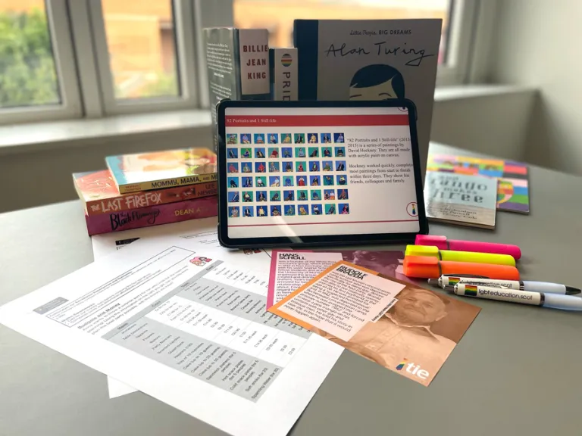
Resources for Teachers
Implementation and Evaluation Toolkit
  Available on the national platform, lgbteducation.scot
  An optional but recommended guide for schools implementing LGBT Inclusive Education
  Allows schools to ensure they are meeting the national expectations for this work
Classroom curriculum resources
  Age and stage appropriate resources for early years, primary and secondary schools
  Includes worksheets, lessons, whole units, educational supports (such as book and media reviews) and displays
  All lessons are fully resourced with PowerPoints, Es, Os & Benchmarks, Learning Intentions and Success Criteria, and
  step-by-step guides to teaching

Slide 7
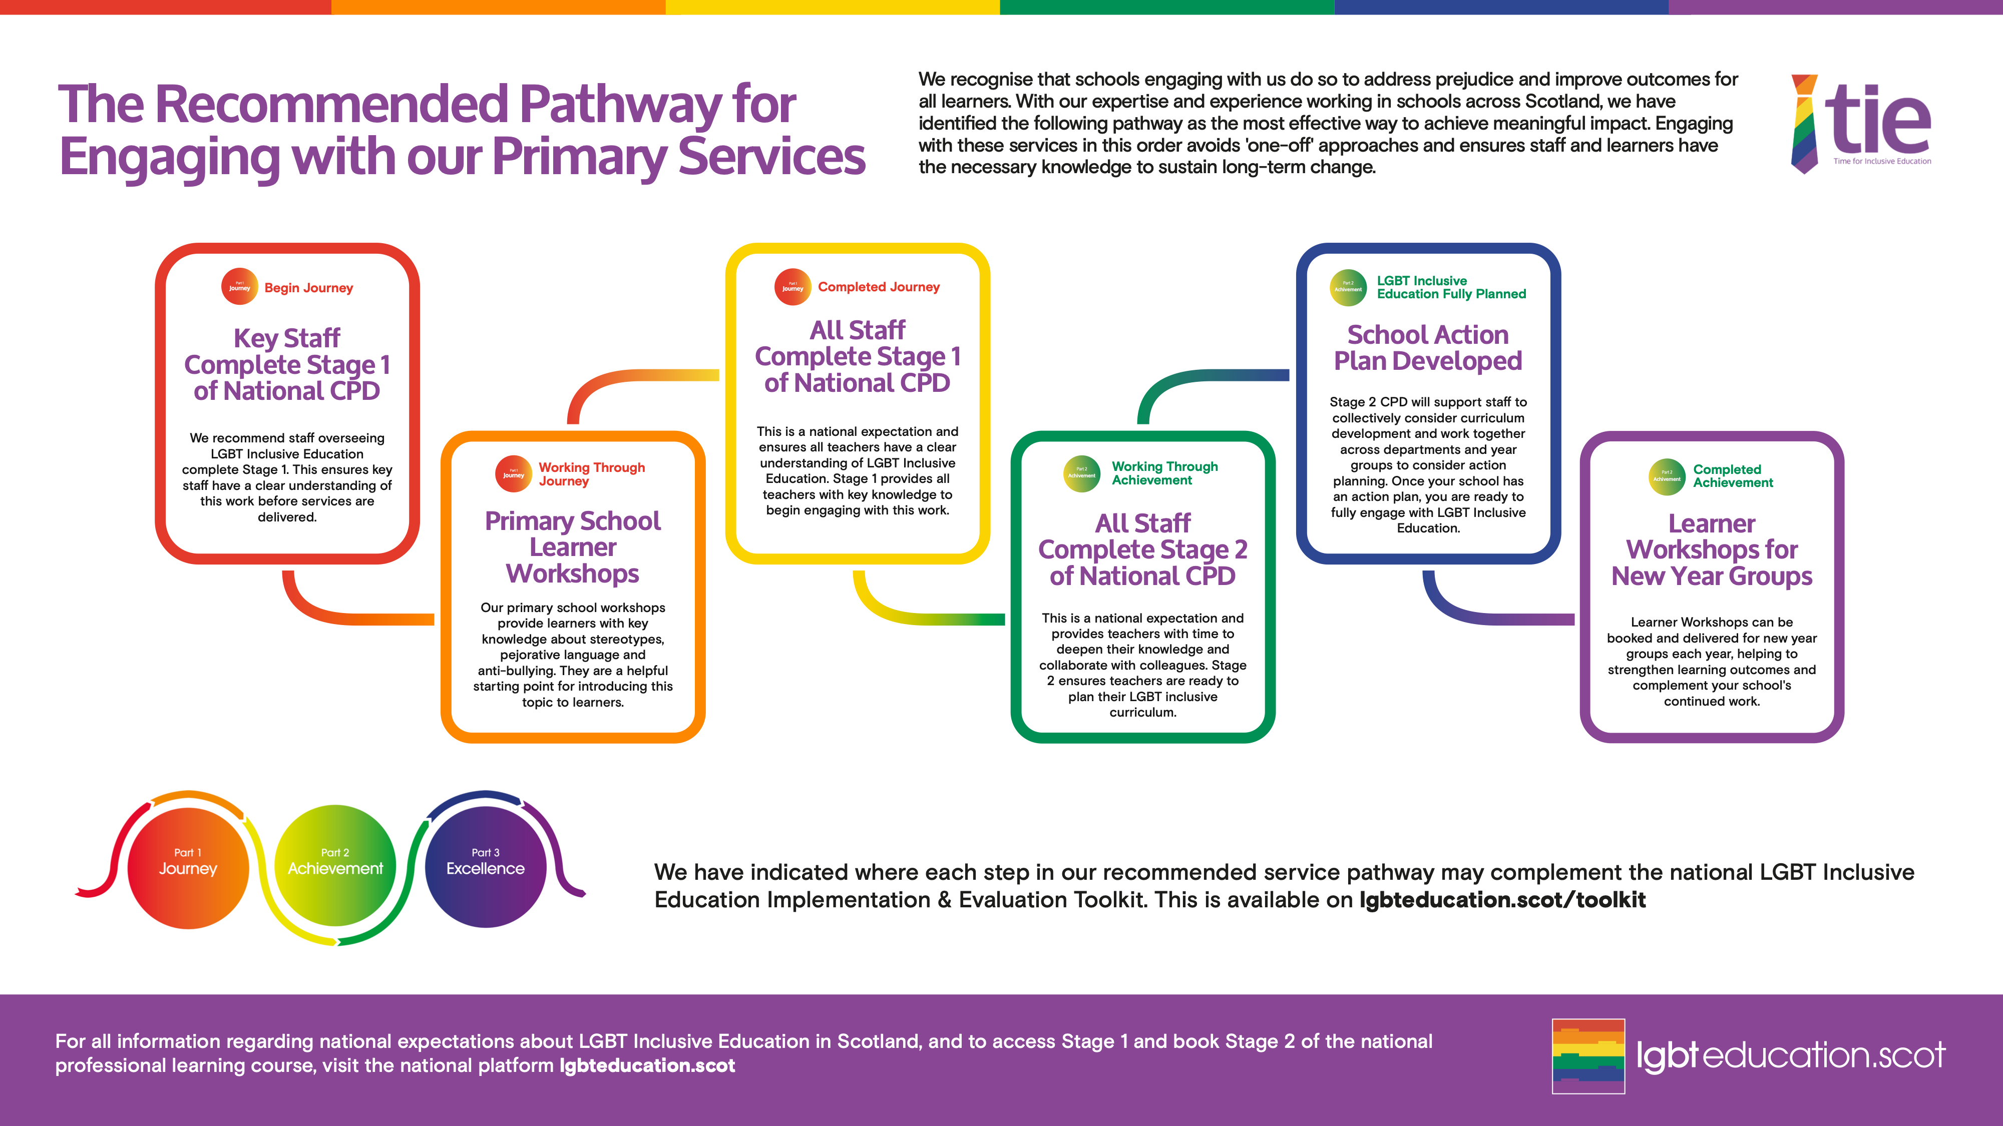

Slide 8
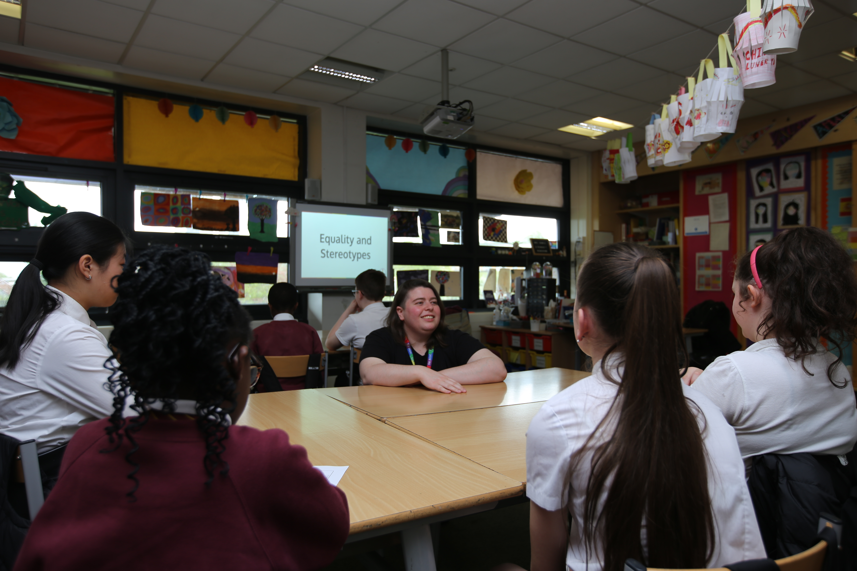
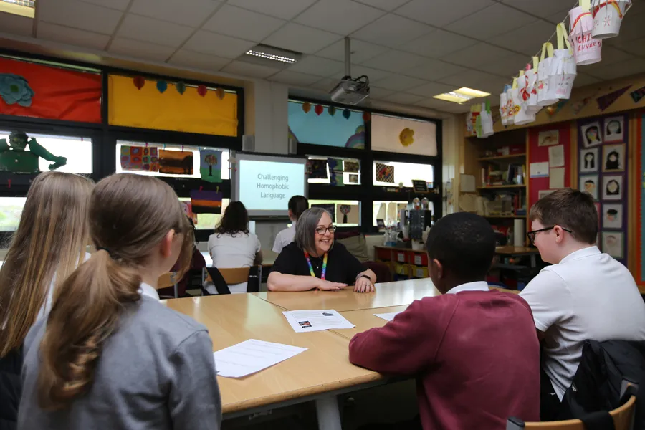
Primary Learner Services
  All school services are delivered free of charge.
Equality & Stereotypes Workshop (P6&7)
  Allows learners to explore stereotypes, difference, equality and inequality
  Encourages critical thinking, appreciation of differences, and treating others with respect
  Challenging Homophobic Language Workshop (P6&7)
  Challenges the use of the word ‘gay’ among young people to mean something inferior or bad
  Encourages empathy, critical thinking and respectful interactions

Slide 9
Our Timeline (optional information slide)
CPD
  Stage 1 E-Learning module to be completed on / by : Date
  Stage 2 Curriculum Development input is booked for: Date
Our Key Staff/Working group
  Name/information
  Name/information
  Etc.
Additional information
  Any other relevant information

